Slide 1
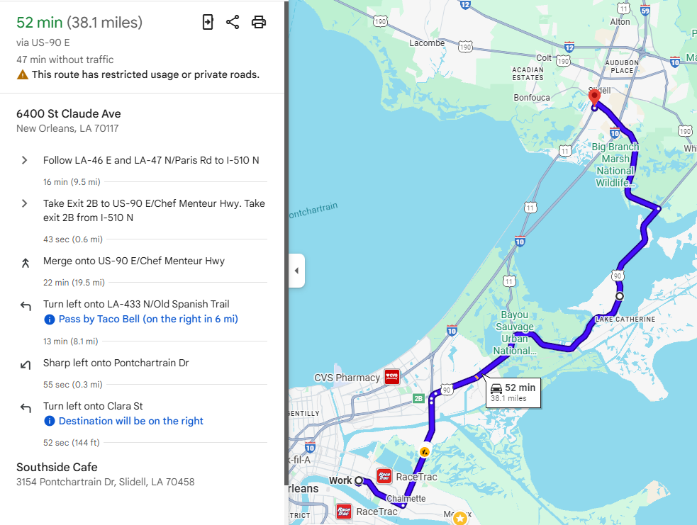
Southside Café
Hours: 1100-2200
Distance: 38 miles
Time: 52 min
Menu: https://places.singleplatform.com/southside-cafe/menu?ref=google#menu_472802

